Slide 1
Chapter 10
Project Analysis and Evaluation
Hillier, Fundamentals of Corporate Finance 4e

Slide 2
Chapter Overview
Evaluating NPV Estimates
Scenario and Other What-if Analyses
Break-Even Analysis
Operating Cash Flow, Sales Volume and Break-Even
Operating Leverage
Capital Rationing

Slide 3
Evaluating NPV Estimates

Slide 4
Evaluating NPV Estimates: Considerations
The Basic Problem
Projected versus Actual Cash Flows
Forecasting Risk
Sources of Value

Slide 5
Scenario and Other What-If Analyses

Slide 6
Methods to Assess Robustness of Analysis
Scenario Analysis
The determination of what happens to NPV estimates when we ask what-if questions.
Sensitivity Analysis
Investigation of what happens to NPV when only one variable is changed.
Simulation Analysis
A combination of scenario and sensitivity analysis.

Slide 7
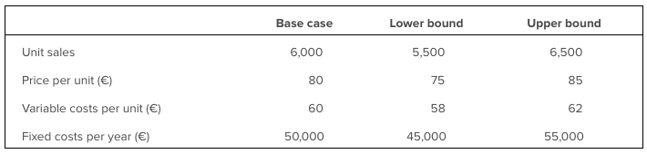
Case Study – Core Analysis
The following project is under consideration:
Cost = €200,000
5-year life, no salvage value
Depreciation is straight-line to zero
Required return = 12 per cent
Tax rate = 34 per cent.
In addition:

Slide 8
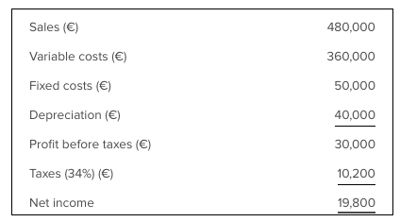
Operating cash flow = €19,800 + 40,000 = €59,800 per year.
At 12 per cent, the 5-year annuity factor is 3.6048, so the base-case NPV = -€200,000 + 59,800 x 3.6048 = €15,567.
The project looks good so far.

Slide 9
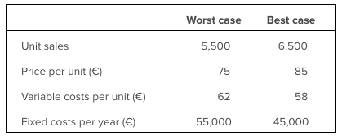
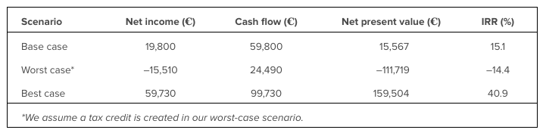
Case Study – Scenario Analysis

Slide 10
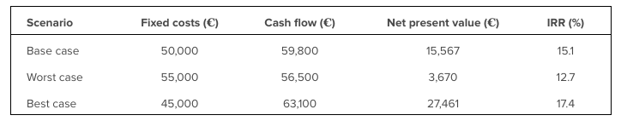
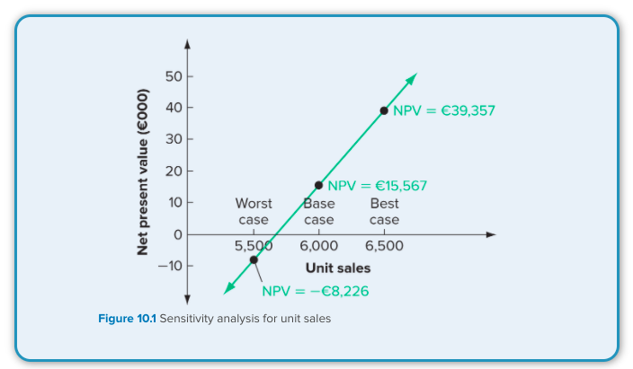
Case Study – Sensitivity Analysis
Freeze Everything except Fixed Costs

Slide 11
Break-Even Analysis

Slide 12
Project Costs Analysis
Fixed Costs
Costs that do not change when the quantity of output changes during a particular time period.
Variable Costs
Costs that change when the quantity of output changes.

Slide 13
Total variable cost = Total quantity of output x Cost per unit of output
VC = Q x v
Variable costs (v) are €2 per unit. If total output (Q) is 1,000 units, what will total variable costs (VC) be?
VC = Q x v = 1,000 x €2 = €2,000
If Q is 5,000 units, then VC will be 5,000 x €2 = €10,000

Slide 14
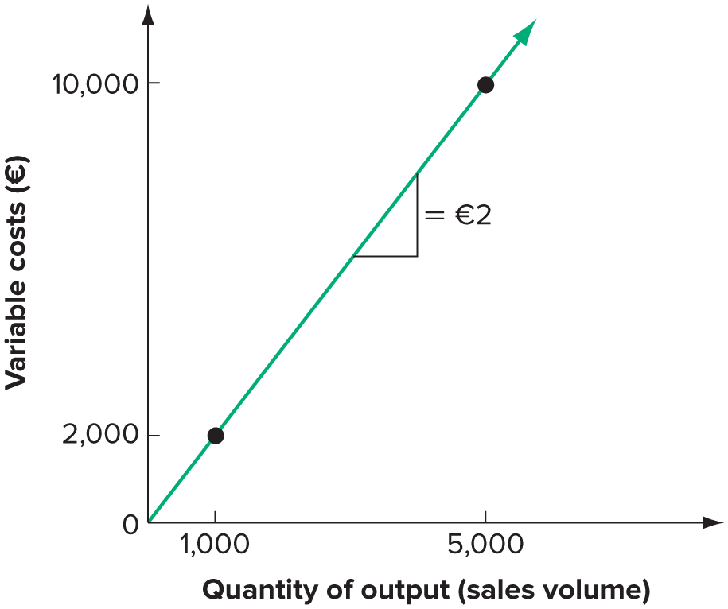

Slide 15
Break-Even Analysis
Total costs (TC) for a given level of output are the sum of variable costs (VC) and fixed costs (FC):
TC = VC + FC
= v x Q + FC
If we have variable costs of €3 per unit and fixed costs of €8,000 per year, our total cost is:
TC = €3 x Q + €8,000
If we produce 6,000 units, our total production cost will be:
€3 x 6,000 + €8,000 = €26,000

Slide 16
Marginal or Incremental Costs
The change in costs that occurs when there is a small change in output.

Slide 17
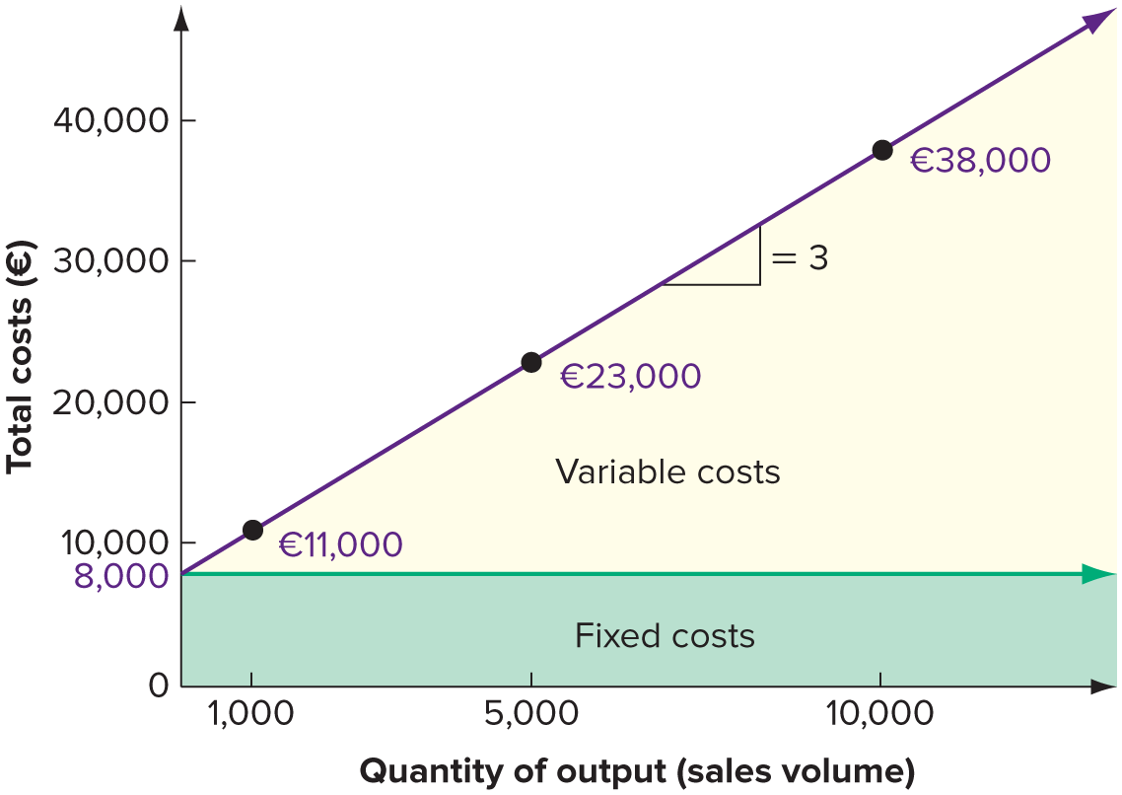

Slide 18
Accounting Break-Even
Accounting Break-Even
The sales level that results in zero project net income.

Slide 19
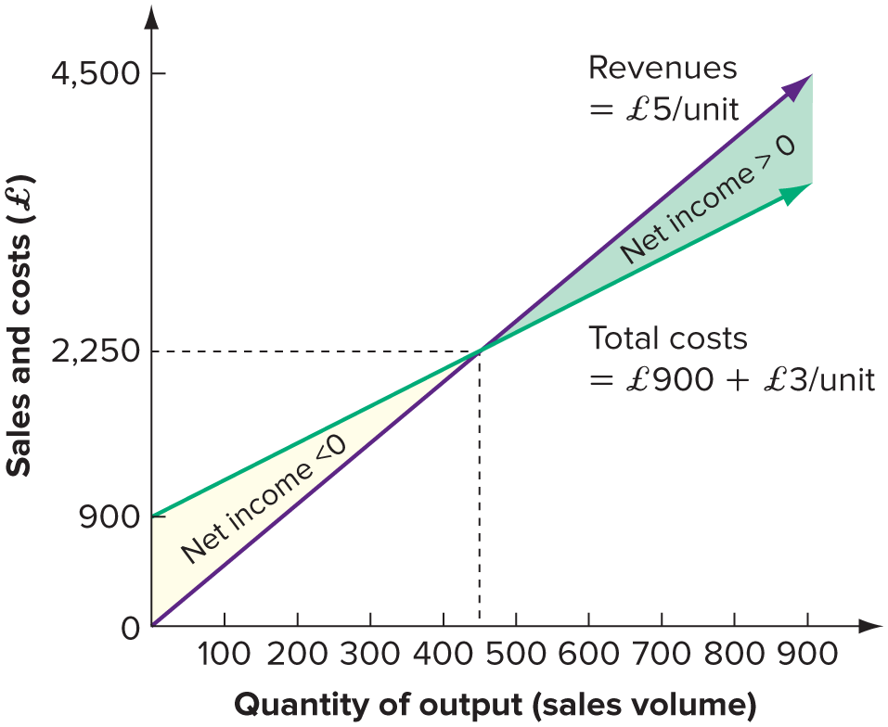

Slide 20
Operating Cash Flow, Sales Volume and Break-Even

Slide 21
Accounting Break-Even: A Closer Look
Variables: P = Selling price per unit
v = Variable cost per unit
Q = Total units sold
S = Total sales = P x Q
VC = Total variable costs = v x Q
FC = Fixed costs
D = Depreciation
T = Tax rate

Slide 22
Accounting Break-Even and Cash Flow
Accounting Break-Even and Cash Flow
A project’s operating cash flow, OCF, can be written as:
OCF = EBIT + Depreciation + Taxes
Sales Volume and OCF
Ignoring taxes a project’s operating cash flow, OCF, can be written as EBIT plus depreciation:
OCF = [(P – v)] x Q – FC – D] + D
= (P – v) x Q - FC

Slide 23
Cash Flow, Accounting and Financial Break-Even Points
We know the relationship between OCF and sales volume ignoring taxes is:
OCF = (P – v) x Q - FC
If we rearrange and solve for Q we get:
Q = FC + OCF
P – v
This tells us what sales volume (Q) is necessary to achieve any given OCF, so this result is more general than the accounting break even.

Slide 24
Cash Break-Even
Cash break-even occurs when operating cash flow is zero.
The cash break even point is thus:
Q = FC
P – v
A project that always just breaks even on a cash basis never pays back, has an NPV that is negative and equal to the initial outlay, and has an IRR of -100 per cent.

Slide 25
Financial Break-Even
Financial break-even occurs when the NPV of the project is zero.
The financial break-even point is thus:
Q = FC + OCF*
P – v
Where OCF* is the level of OCF that results in a zero NPV.
A project that breaks even on a financial basis has a discounted payback equal to its life, a zero NPV and an IRR just equal to the required return.

Slide 26
Operating Leverage

Slide 27
What is Operating Leverage?
Operating Leverage
The degree to which a firm or project relies on fixed costs

Slide 28
Degree of Operating Leverage (DOL)
The percentage change in operating cash flow relative to the percentage change in quantity sold

Slide 29
Degree of Operating Leverage (DOL)
Percentage change in OCF =
DOL x Percentage change in Q
Based on the relationship between OCF and Q, DOL can be written as:
DOL = 1 + FC/OCF

Slide 30
Capital Rationing

Slide 31
Types of Capital Rationing
Capital Rationing
The situation that exists if a firm has positive NPV projects but cannot find the necessary financing.
Soft Rationing
The situation that occurs when units in a business are allocated a certain amount of financing for capital budgeting.
Hard Rationing
The situation that occurs when a business cannot raise financing for a project under any circumstances.

Slide 32
Concept Quiz

Slide 33
What is meant by forecasting risk and why is it a concern for a financial manager?
What are scenario, sensitivity and simulation analyses? What are the drawbacks to these various what-if analyses?
Why might the accounting break-even point be of interest to a financial manager? If a project does break-even on an accounting basis, what is its operating cash flow?

